Slide 1
A Study Of The Book Of Revelation
November 15, 2020

Slide 2
Resources used:
A Study Of The Book Of Revelation by Bob Dodson
More Than Conquerors by William Hendriksen
Overcoming With The Lamb, Florida College Annual Lectures, February 7-10, 1994
Revelation: An Introduction and Commentary by Homer Hailey
Revelation (Truth Commentaries) by Robert Harkrider
Revelation (A Study Workbook) by Robert Harkrider
Revelation by Donnie Rader
Revelation charts by Keith Greer.
Studies In The Book Of Revelation by Ferrell Jenkins
The Old Testament In The Book Of Revelation by Ferrell Jenkins
The Revelation Of Saint John The Divine by G.B. Caird
The Book of Revelation by Foy E. Wallace
The Avenging of the Apostles and Prophets by Arthur M. Ogden
Worthy Is The Lamb by Ray Summers
Written exchange on “The Domitian Persecution” between Arthur M. Ogden and Ferrell Jenkins presented in Searching The Scriptures, June 12, 1989, pages 7-12

Slide 3
Revelation
I. Struggle on Earth (1-11)
A. John’s Vision (1)
B. Letters to 7 churches (2-3)
C. God in control (4-5)
D. Opening of seven seals (6-11)

Slide 4
Revelation 9
“Fifth and Sixth Trumpets”
Outline
The Fifth Trumpet: The Locusts (verses 1-12)
The Sixth Trumpet: Angels and Horsemen (verses 13-21)

Slide 5
Revelation 9
“Fifth and Sixth Trumpets”
Outline
The Fifth Trumpet: The Locusts (verses 1-12)
Their source (verses 1-3a)
Their mission (verses 3b-6)
Their description (verses 7-10)
Their king (verses 11-12)

Slide 6
Revelation 9
“Fifth and Sixth Trumpets”
MAIN THEME: The transgressor who will not repent brings destruction upon himself as well, as he shall feel the wrath of almighty God! (Proverbs 11:3, 5, 6, 17, 19, 21, 23, 27, 29, 31).
Should I really envy the prosperity of wicked?
Should I fret because it seems like the wicked have the fat of the earth?

Slide 7

Revelation 9:1
Revelation 9
“And the fifth angel sounded, and I saw a star from heaven fallen unto the earth: and there was given to him the key of the pit of the abyss.”

Slide 8
Revelation 9:2
Revelation 9
“And he opened the pit of the abyss; and there went up a smoke out of the pit, as the smoke of a great furnace; and the sun and the air were darkened by reason of the smoke of the pit.”

Slide 9
The Fifth Angel
Revelation 9
Star falls from heaven (Agent of Satan personified).
“When Jesus said in Luke 10:18, ‘I beheld Satan fall as lightning from heaven,’ he meant the complete defeat of all the personified agents of Satan. By his fall from heaven, Jesus meant that Satan would be dethroned from his exalted dominion; and his downfall would come swiftly as lightning in the shaping conflict.” (Foy Wallace)
In Isaiah 14:12 The prophet spoke of a Babylonian ruler. It referred to the downfall of the ruler, personified as Lucifer.
The name Lucifer in the Septuagint, is translated “Star,” which was represented as falling from heaven – the wicked king’s exalted place of dominion.

Slide 10
The Fifth Angel
Revelation 9
Star falls from heaven (Agent of Satan personified).
Satan defeated. Hebrews 2:14-15
The star falling “from heaven unto the earth” merely denoted the descent of the ruler from an exalted dominion to a degenerate place of activity among the powers of men. (Wallace)
Given the key to the bottomless pit.
The pit was open.
Smoke like the smoke of a great furnace escaped from the pit.
The great smoke darkened the sun and air.

Slide 11
The Fifth Angel
Revelation 9
The fifth trumpet sounds the warnings as the devilish forces are unleashed.
They shall torment those who do not have the “seal of God on their foreheads” (saints). cf. 7:2-3
Punishment is unleashed on those who have committed heinous crimes against God and His people.

Slide 12
The Fallen Star
Revelation 9
The star “a messenger” came from heaven to earth.
Perhaps personifying Satan. (Revelation 11:7; 17:8; 20:1-3)
Key to the “abyss” (bottomless pit)
This is the abode of demons. (Luke 8:31)
Preliminary punishment for fallen angels, the beast (17:8)
Final abode for Satan himself (20:3)
Satan has control over the demonic forces

Slide 13
Revelation 9:3
Revelation 9
“And out of the smoke came forth locusts upon the earth; and power was given them, as the scorpions of the earth have power.”

Slide 14
Revelation 9:4
Revelation 9
“And it was said unto them that they should not hurt the grass of the earth, neither any green thing, neither any tree, but only such men as have not the seal of God on their foreheads.”

Slide 15
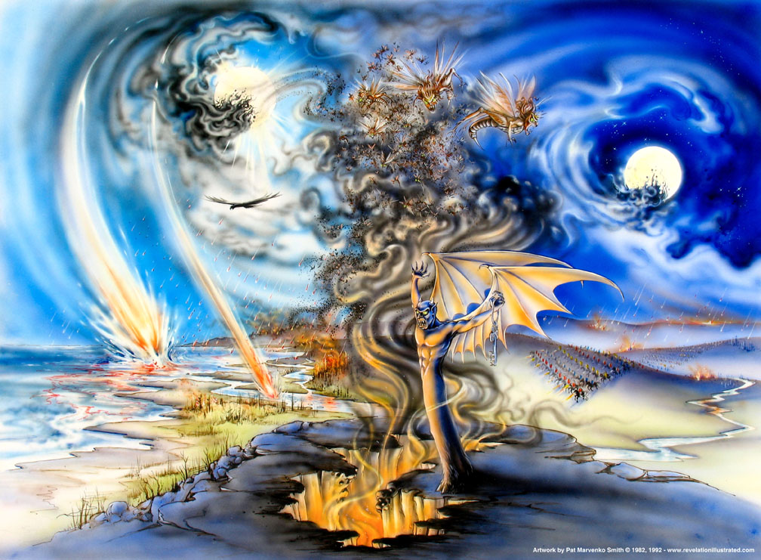
Revelation 9

Slide 16
The Tormenting Locusts
Revelation 9
Locusts were a common pest in that day.
From the time of Moses they were the instruments of divine judgment as in Exodus 10:4-15
Various illustrations in the Bible are drawn from their characteristic features (Deuteronomy 28:38; Joel 2:1-11, 25; 2 Chronicles 7:13; Psalms 105:34; Nahum 3:15).
These locusts that could sting like a scorpion were emerging from the bottomless pit, causing great pain.

Slide 17
The Tormenting Locusts
Revelation 9
Tormenting locusts arise from the pit out of the smoke.
Power over only those not numbered with the 144,000 (sealed).
Given power as the scorpions on earth have power
They are not to eat the earth’s vegetation, grass, or any green thing.
Their mission is to hurt and torment.

Slide 18
The Smoke and Darkness
Revelation 9
Smoke and darkness tend to “blind” men.
This plague of evil causes men to be blind to their sins.
Sin has a vicious sting – it hurts, but it is not yet fatal. cf. Galatians 6:7-8
Proverbs 13:15-16, “Good understanding giveth favor; But the way of the transgressor is hard. Every prudent man worketh with knowledge; But a fool flaunteth (his) folly.”
Those who subjected God’s people to much torment will receive much worse in return!

Slide 19
Revelation 9:5
Revelation 9
“And it was given them that they should not kill them, but that they should be tormented five months: and their torment was as the torment of a scorpion, when it striketh a man”

Slide 20
Revelation 9:6
Revelation 9
“And in those days men shall seek death, and shall in no wise find it; and they shall desire to die, and death fleeth from them.”

Slide 21
Mission of the Locusts
Revelation 9
Power is limited for only “five months.”
Commanded not to kill – just torment.
Torment is like a scorpion’s sting.
For some extended period of time, men will experience something worse than death.
Death would be preferred, but it cannot be found. (cf. 6:15-16; cf. Luke 21:26, Matthew 24:22, and Mark 13:12, 20)
Could it be the “inner corruption” that leads to moral and spiritual decadence?

Slide 22
Revelation 9:7
Revelation 9
“And the shapes of the locusts were like unto horses prepared for war; and upon their heads as it were crowns like unto gold, and their faces were as men's faces.”

Slide 23
Revelation 9
Revelation 9:8
“And they had hair as the hair of women, and their teeth were as (teeth) of lions.”

Slide 24
Revelation 9:9
Revelation 9
“And they had breastplates, as it were breastplates of iron; and the sound of their wings was as the sound of chariots, of many horses rushing to war.”

Slide 25
Revelation 9:10
Revelation 9
“And they have tails like unto scorpions, and stings; and in their tails is their power to hurt men five months.”

Slide 26
Descriptions of the Locusts
Revelation 9
The locusts:
Were shaped like horses prepared for battle.
Wore something shaped like golden crowns on their heads.
Had faces like the faces of men.
Had breastplates like breastplates of iron.
Had wings that sounded like chariots with many horses running into battle.
Had tails like scorpions and stings in their tails.
Had power that was limited to “five months.”

Slide 27
Descriptions of the Locusts
Revelation 9
Like horses prepared for battle – (powerful)
Wore crowns (like victors)
Had faces of men (intelligent)
Had hair like the hair of women (beautiful)
Had teeth like the teeth of lions (powerful)
Wore breastplates of iron (protection)
Had wings that sounded like many chariots
Had tails like scorpions (tormenting power)

Slide 28
Revelation 9:11
Revelation 9
“They have over them as king the angel of the abyss: his name in Hebrew is Abaddon, and in the Greek (tongue) he hath the name Apollyon.”

Slide 29
Revelation 9:12
Revelation 9
“The first Woe is past: behold, there come yet two Woes hereafter.”

Slide 30
Their King
Revelation 9
Hebrew – Abaddon
Greek – Apollyon
Both names mean “destruction and destroyer.”
Wrecker of everything that is fine and holy
Abyss is on earth not in heaven – abode of all ungodly BEFORE judgment!
Luke 16:23; 2 Peter 2:4; Jude 6

Slide 31
Summary
Revelation 9
God has now used two instruments to cut down the oppression of His people:
Natural calamity
Internal decadence
Rome fell for Satan’s lies.
Internal decay was one of the reasons for her fall.
ONE down – two to go!
The ungodliness of the time is summarized in Romans 1:18-32.

Slide 32
Revelation 9:13
Revelation 9
“And the sixth angel sounded, and I heard a voice from the horns of the golden altar which is before God,”

Slide 33
Revelation 9:14
Revelation 9
“one saying to the sixth angel that had one trumpet, Loose the four angels that are bound at the great river Euphrates.”

Slide 34
Sixth Angel Sounds
Revelation 9
A voice calls out from the horns of the golden altar in heaven.
Altar of burnt incense (Exodus 30:1-10)
Souls under the altar (6:10; 8:3-5)
Altar is before God – power of the requests of the saints
Loose the four angels that are bound at the great river Euphrates

Slide 35
Sixth Angel Sounds
Revelation 9
River Euphrates stands for the military might of the enemy. (More fully developed in 16:12.)
Largest, longest, and most important river in Western Asia. Nearly 1,800 miles long and was the boundary of the land promised to Abraham (Genesis 15:18).
The empires of Assyria and Babylon lived east of the Euphrates.
The prophets often put the Euphrates by metonymy for these countries to designate the place from which the punishment of God would come. (Isaiah 7:20; 8:7; Jeremiah 46:10; cf. Isaiah 10:5-6)

Slide 36
Sixth Angel Sounds
Revelation 9
Homeland of the Parthians – the world’s most dreaded cavalry (fought Rome in 53 and 62 AD)
These ARE NOT the angels in 7:1, who were restraining the four winds.
Being bound means not permitted to act until God permits.

Slide 37
Revelation 9:15
Revelation 9
“And the four angels were loosed, that had been prepared for the hour and day and month and year, that they should kill the third part of men.”

Slide 38
Revelation 9:16
Revelation 9
“And the number of the armies of the horsemen was twice ten thousand times ten thousand: I heard the number of them.”

Slide 39
The Army
Revelation 9
The angels were perpetually prepared for the time of their release.
Predetermined by God for this very hour.
Remember, “4” is the world number.
This judgment being released will be a world-wide judgment.
Against all wicked and unregenerate men.
God prepared these angels for this certain time.

Slide 40
The Army
Revelation 9
Two hundred million! A tremendous host. “Summers calculated they would cover an area one mile wide and eighty-five miles long. The literalist cannot find the space to fit an army this size into the valley of Jezreel for a battle of Armageddon!” (Robert Harkrider, Revelation, Truth Commentaries, Page 185)

Slide 41
The Army
Revelation 9
Two hundred million! A tremendous host.
Figurative number representing a vast, inconceivable force – invincible.
Scare the enemy and assure God the victory!
Forces assemble to do God’s bidding – external invasion.

Slide 42
Revelation 9
“The whole picture presents the Parthian cavalry from the land of the Euphrates. This group was Rome’s most dreaded enemy and a constant threat to her eastern boundary … This whole picture is given to symbolize external invasion which would serve as an instrument in God’s hand to punish the oppressors of his people.”
– Ray Summers, Worthy Is The Lamb, Page 159

